Slide 1
Visual Sudoku Solver
Ahmet Bağlan
<number>
Notes:
...today I’ll be talking to you about how we conduct machine learning experiments here at Sift.

Slide 2
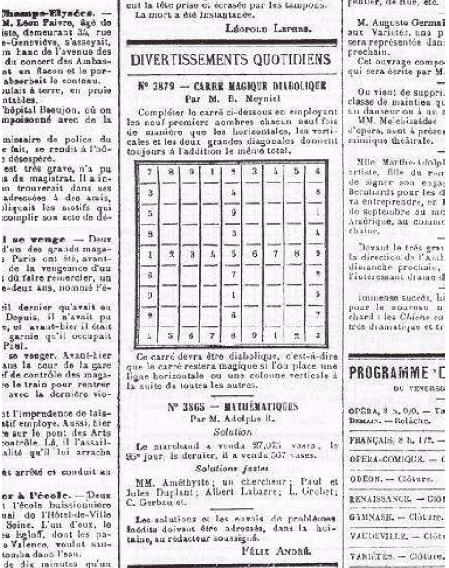
Sudoku
9 x 9 number puzzle
In every column, row and 3x3 square a number occurs only once.
<number>

Slide 3
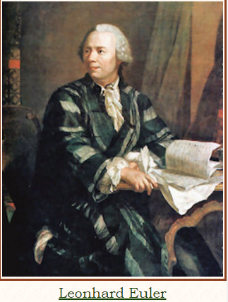
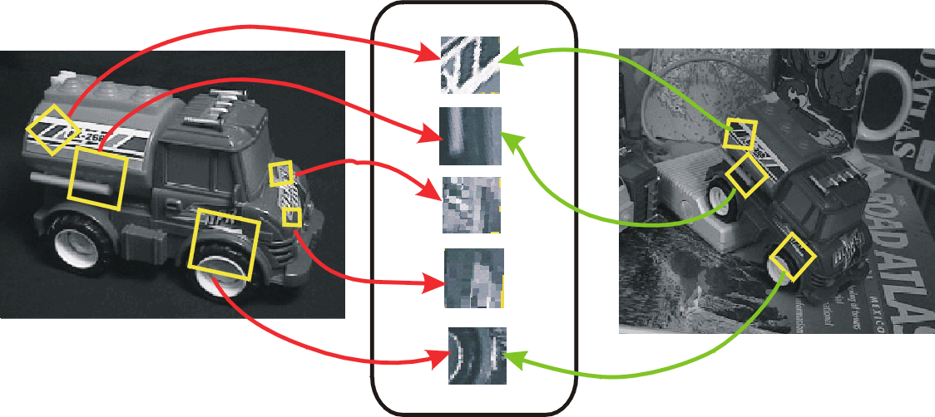
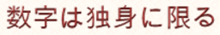
Sudoku (数 独)
Euler himself created a game similar to Sudoku.
French nerspaper
Journey To America
Journey To Japan
数 独 Su (meaning 'number') and Doku (meaning 'single')
<number>
Notes:
Number Place
Suuji wa dokushin ni kagiru meaning 'the numbers must occur once only'

Slide 4
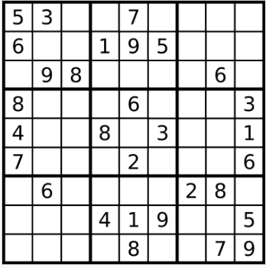
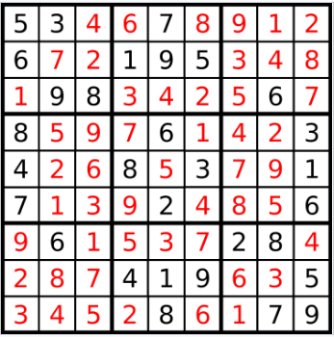
What is Visual Sudoku Solver?
Extractor
Solver
Image Generator
<number>
Notes:
Ok, so here is the motivation for the talk, starting with the basics:
We must conduct experiments to improve a machine learning system
We need our evaluation system to indicate experiments that help the system are good, and those that hurt the system are bad. You can think of your evaluation framework as a sort of meta loss function for your entire ML stack; you want changes to your system allowed by the evaluation framework to be minimizing error over time.
However, conducting these experiments without introducing bias is often very tricky. Getting this wrong can lead to wasted effort and in the worst case optimizing a system away from its ideal operating point. E.g. ignoring class skew and using precision/recall of the dominant class leads to the always positive classifier
Must run experiments
Experiments must be correct
Easy to get them wrong, which is why you should think about this

Slide 5
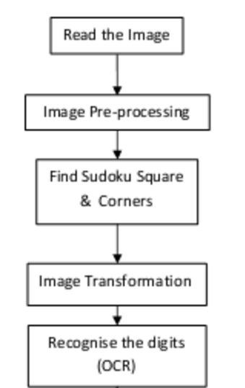
Extractor
Returns two dimensional array representing Sudoku
Indices corresponding to empty squares are assigned
to 0
OPENCV library
<number>

Slide 6
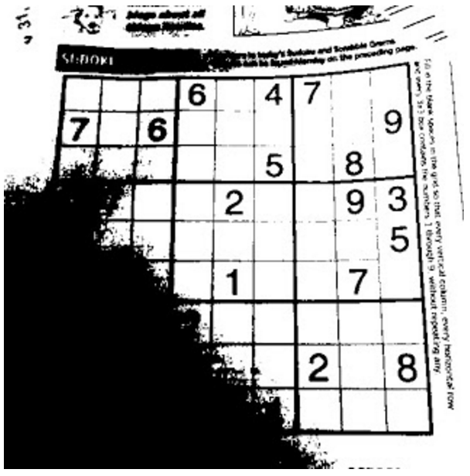
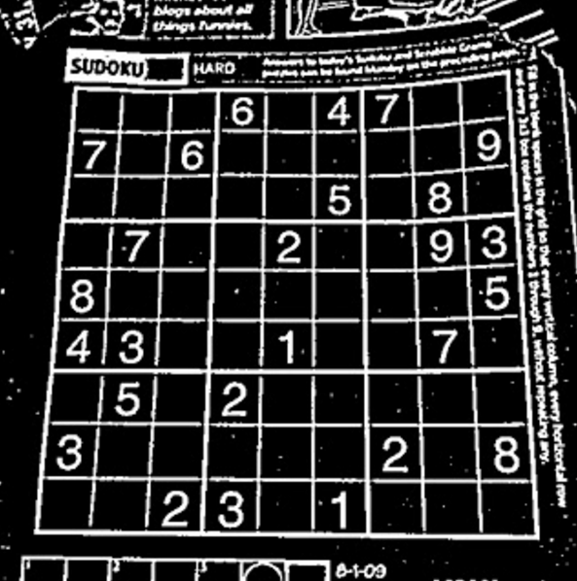
Image Preprocessing: Thresholding
Adaptive Thresholding
<number>

Slide 7
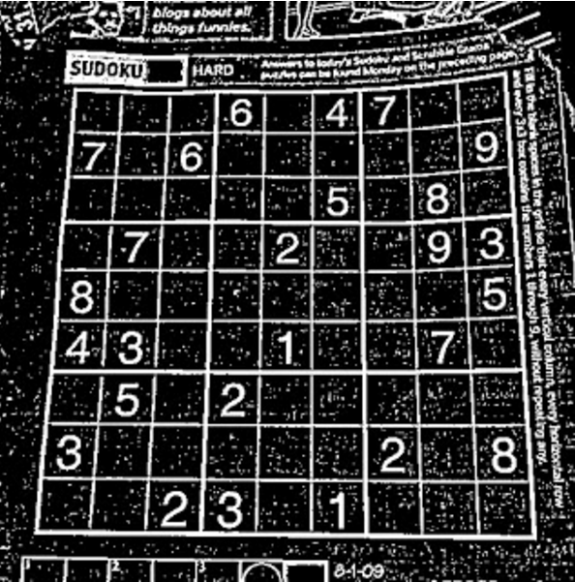
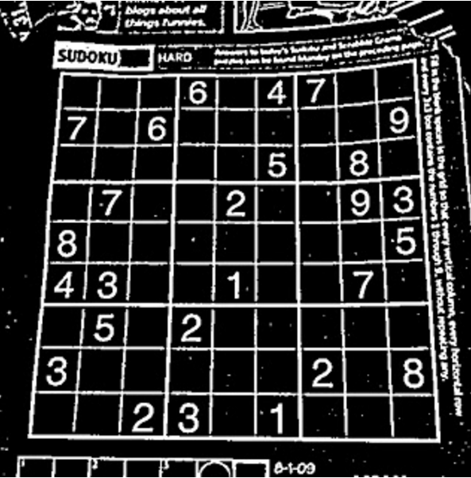
Image Preprocessing: Blurring
Gaussian blur is used to reduce noise after thresholding.
<number>

Slide 8
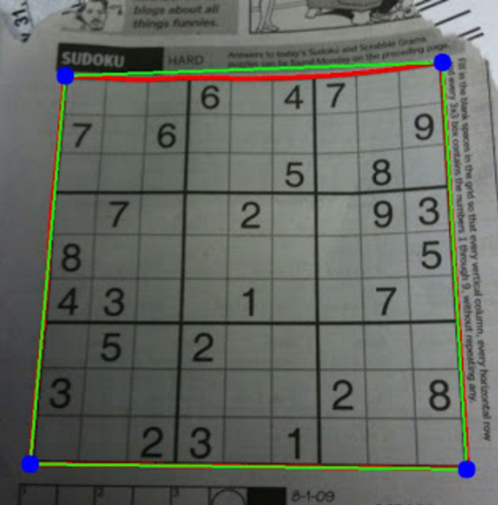
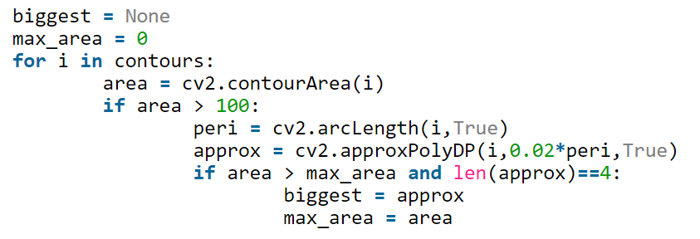
Find Squares: Contours
We assume the biggest contour corresponds to the Sudoku Square.
<number>

Slide 9
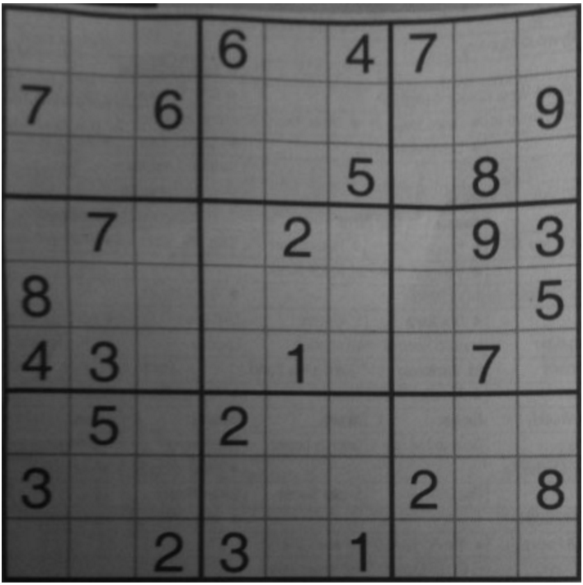
Image Transformation: Warp & Resize
Get the puzzle to a known size.
<number>

Slide 10
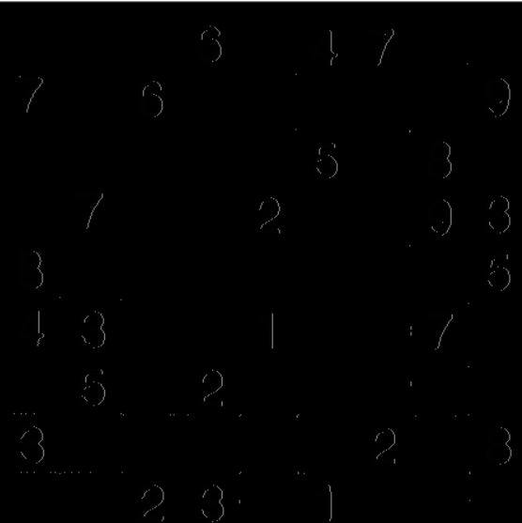
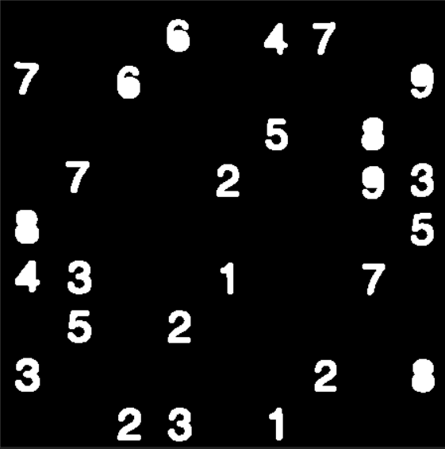

Extract Digit Contours
Flood the image Find contours
<number>

Slide 11
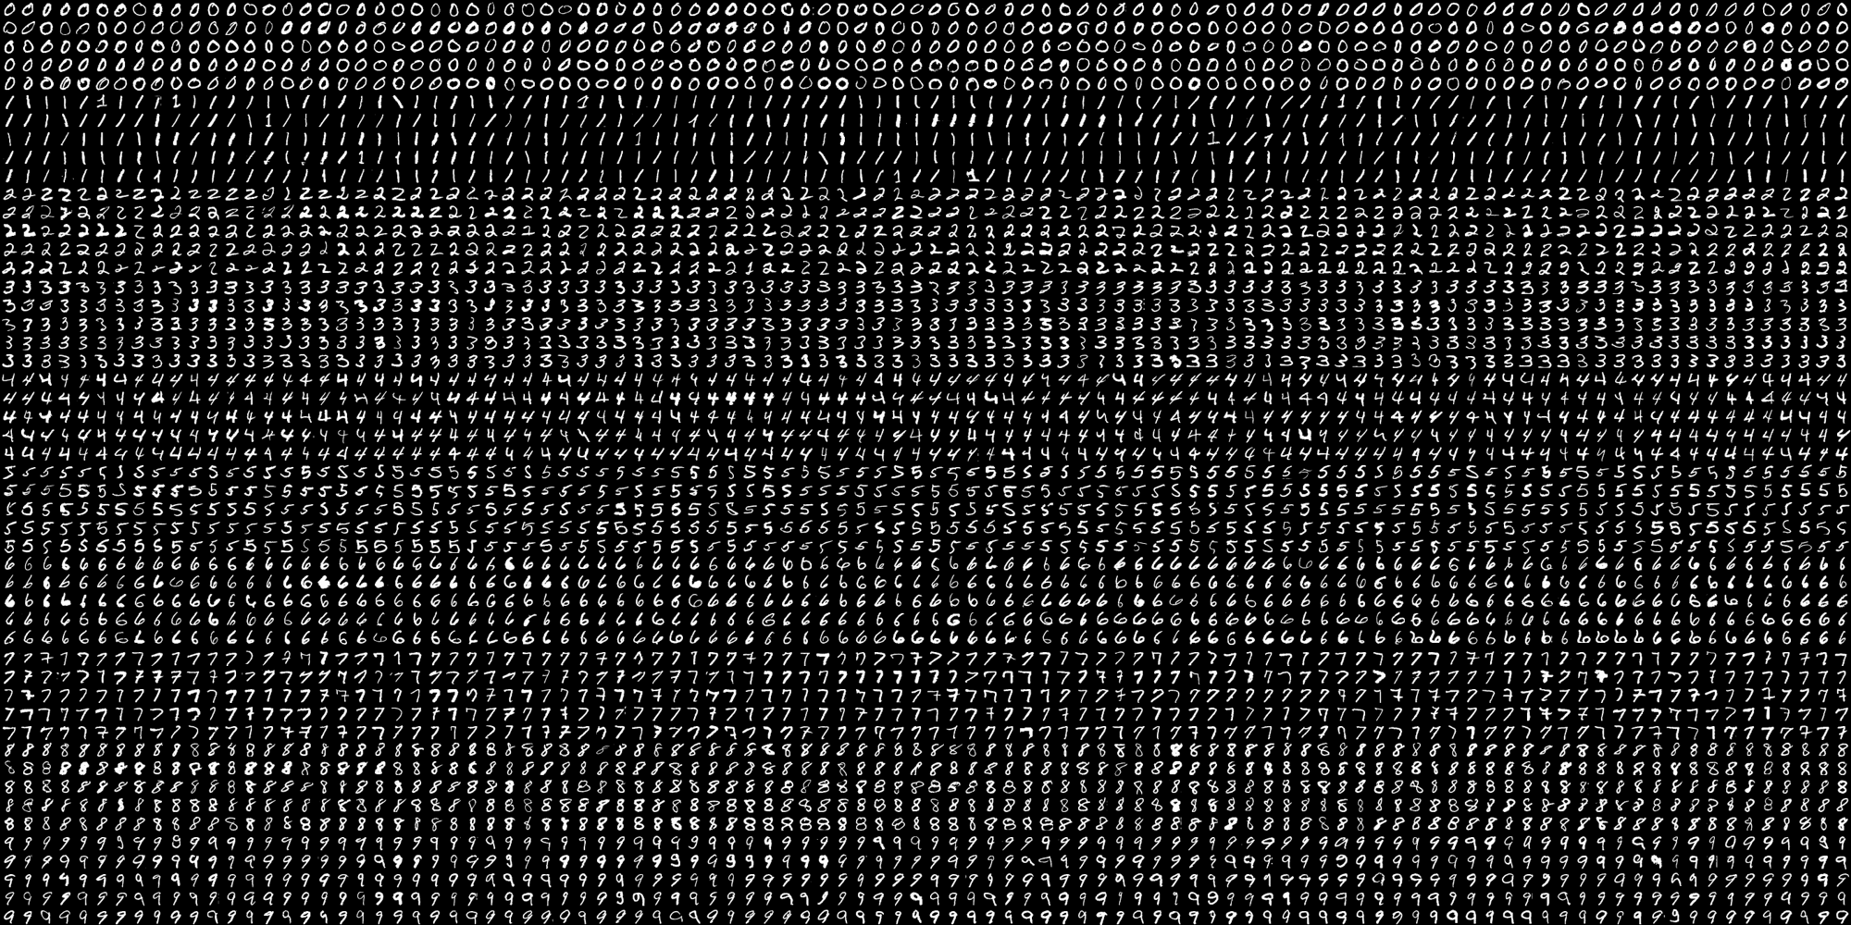
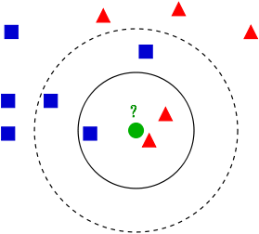
Recognize Digit
Hand written Data set
KNN algorithm
20x20 pixel for each digit so 400 feature
Distance Threshold
<number>

Slide 12
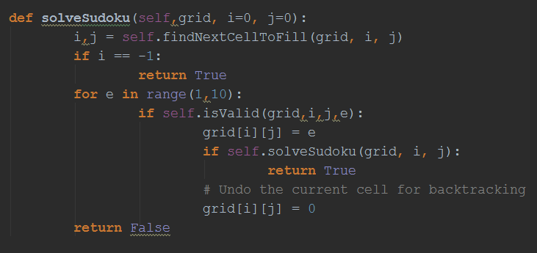
Sudoku Solver
We dealt with the problem of solving Sudoku numbers with exhaustive enumeration.
<number>

Slide 13
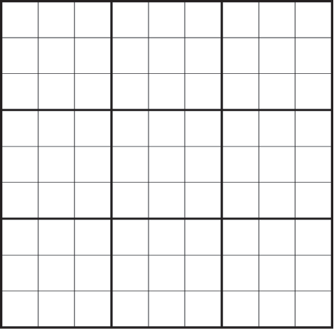
Output Generator
We take a base grid to fill it with the
numbers we have.
Black numbers stand for the numbers
that we already have.
Green numbers stand for the numbers
that we get with our algorithm.
<number>

Slide 14
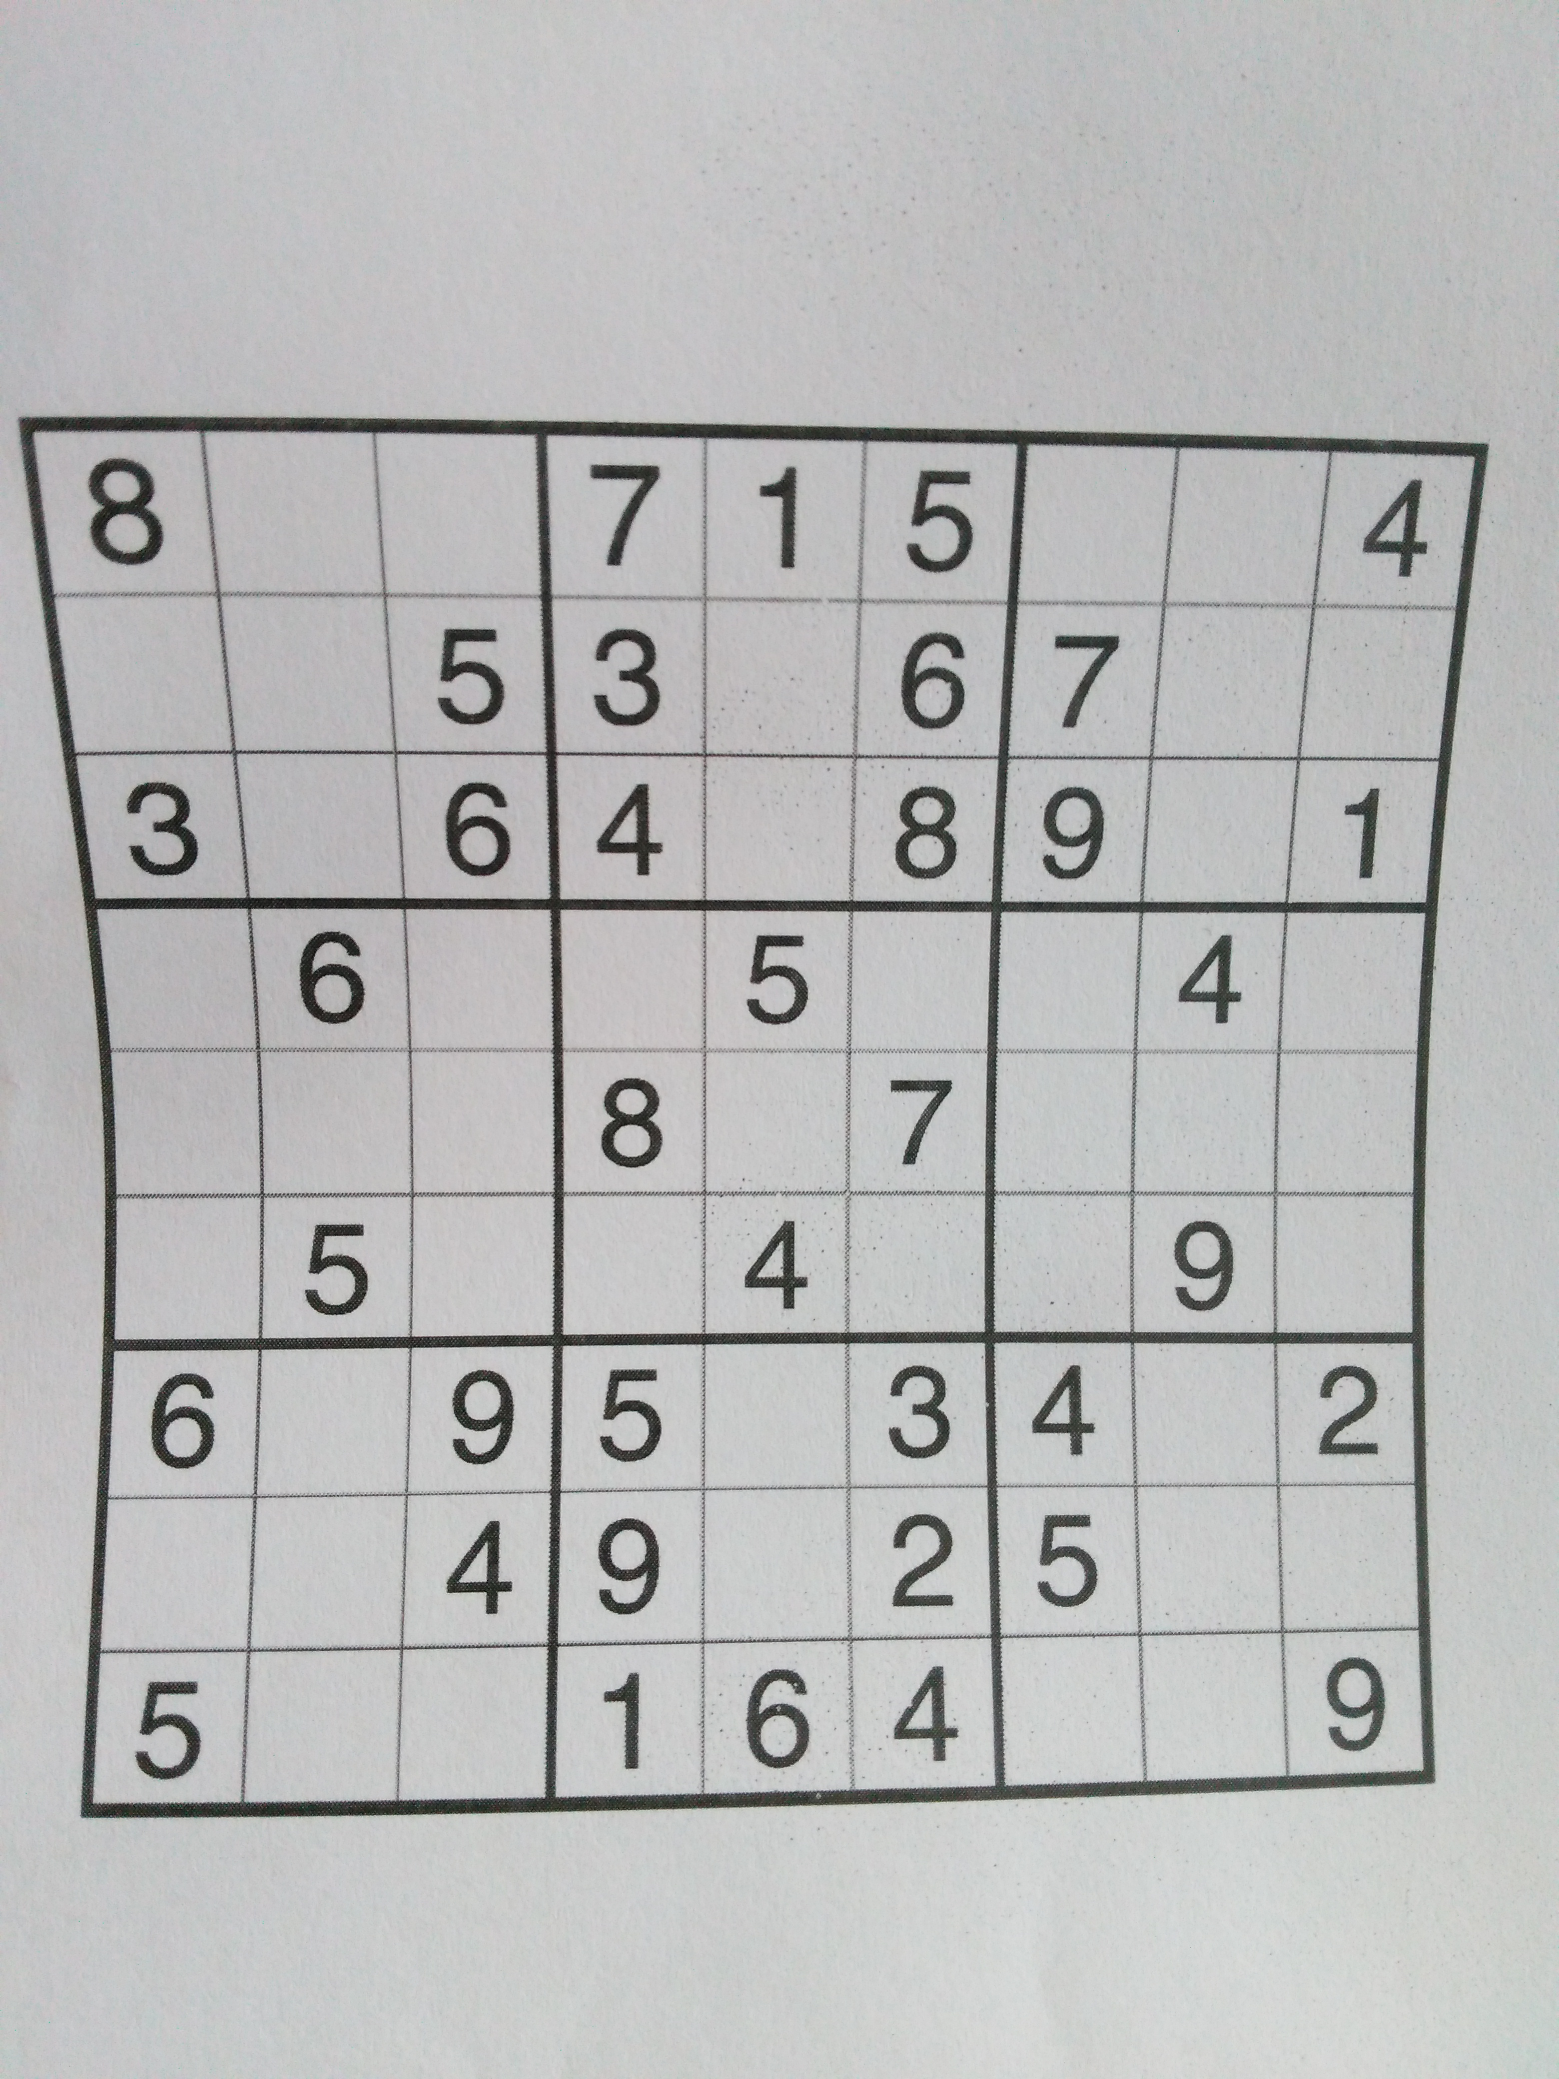
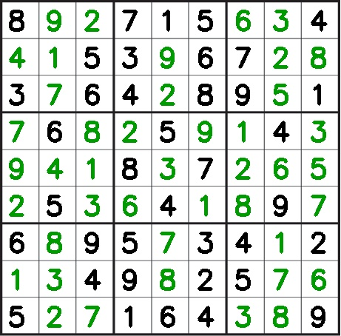
Example Solution
<number>

Slide 15
What next?
Sudoku Specialized OCR
Mobile Application
Error resilient solver
<number>

Slide 16
Thank you for listening
Questions?
<number>

